Slide 1
Environment and software set up
Yolov5
Anaconda (virtual environment with different libraries for python development)
Pycharm (Python IDE)
cuda10.2
cudnn-10.2-windows10-x64-v7.6.5.32
pytorch1.5.1
Python libraries (numpy, pillow, opencv, and so on)
LabelImg (labeling)

Slide 2
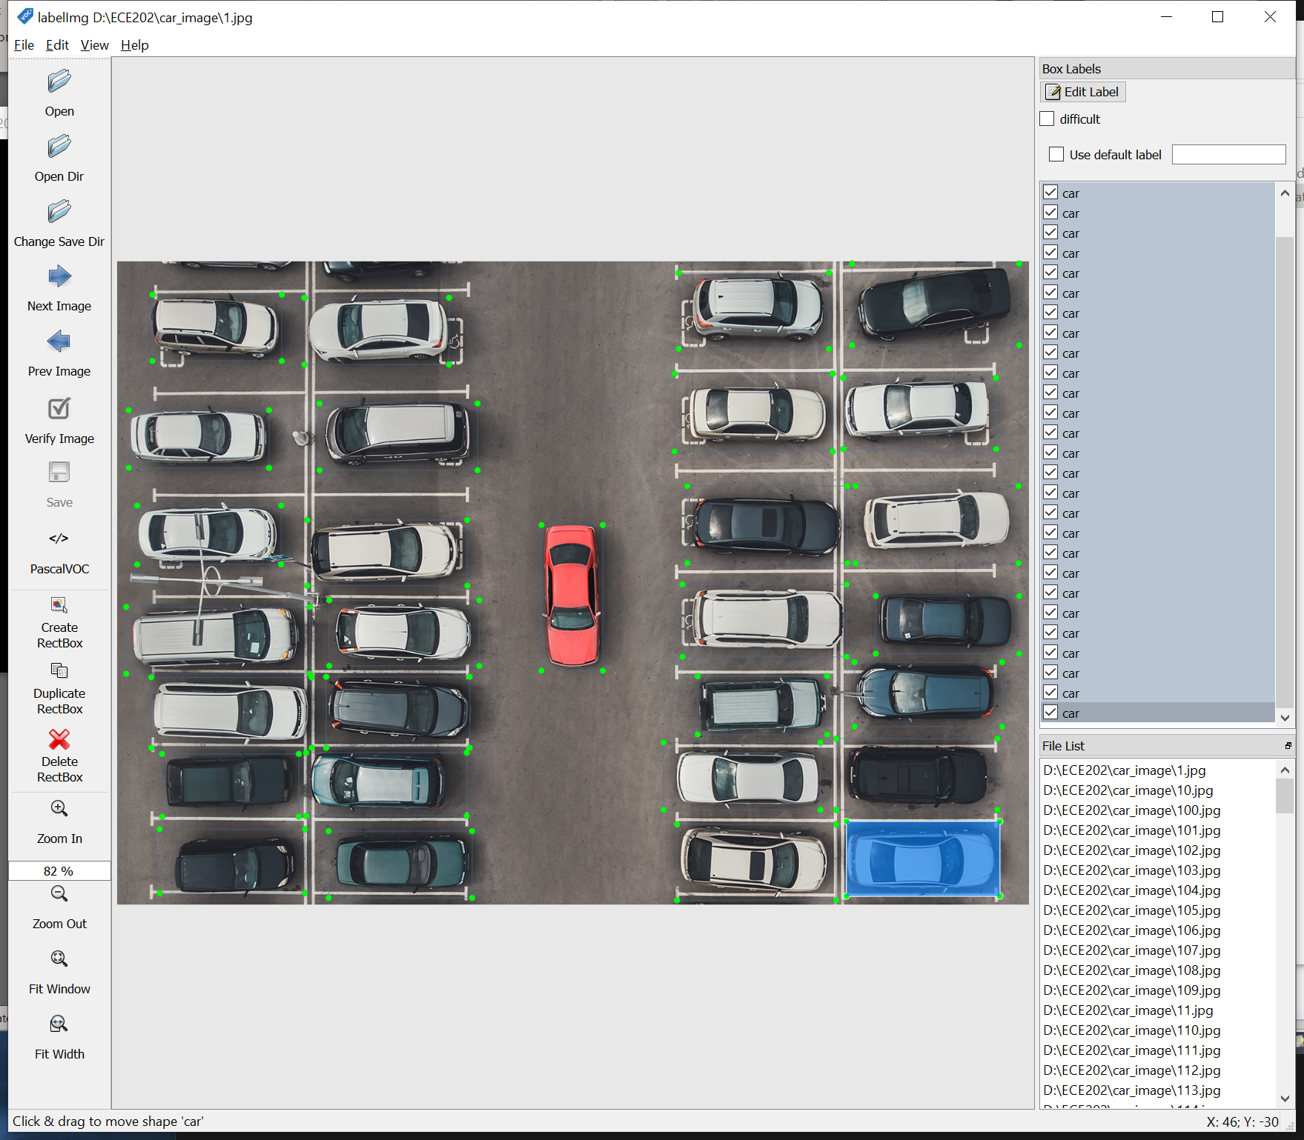
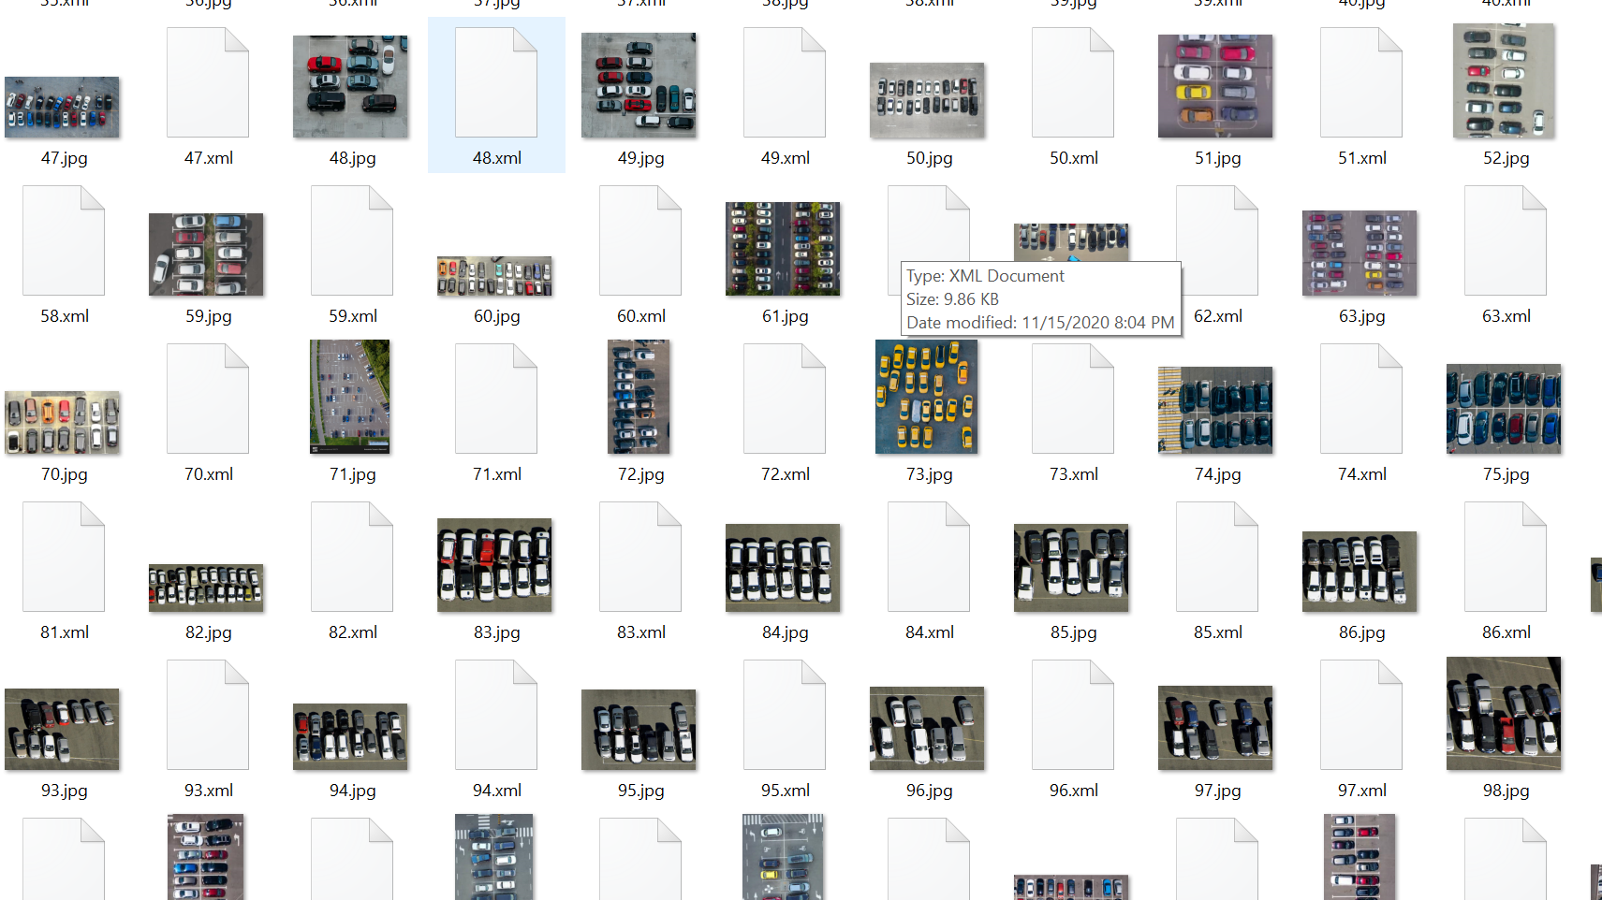
Creating training data set
About 150 car top view images
Using LabelImg to label out the cars

Slide 3
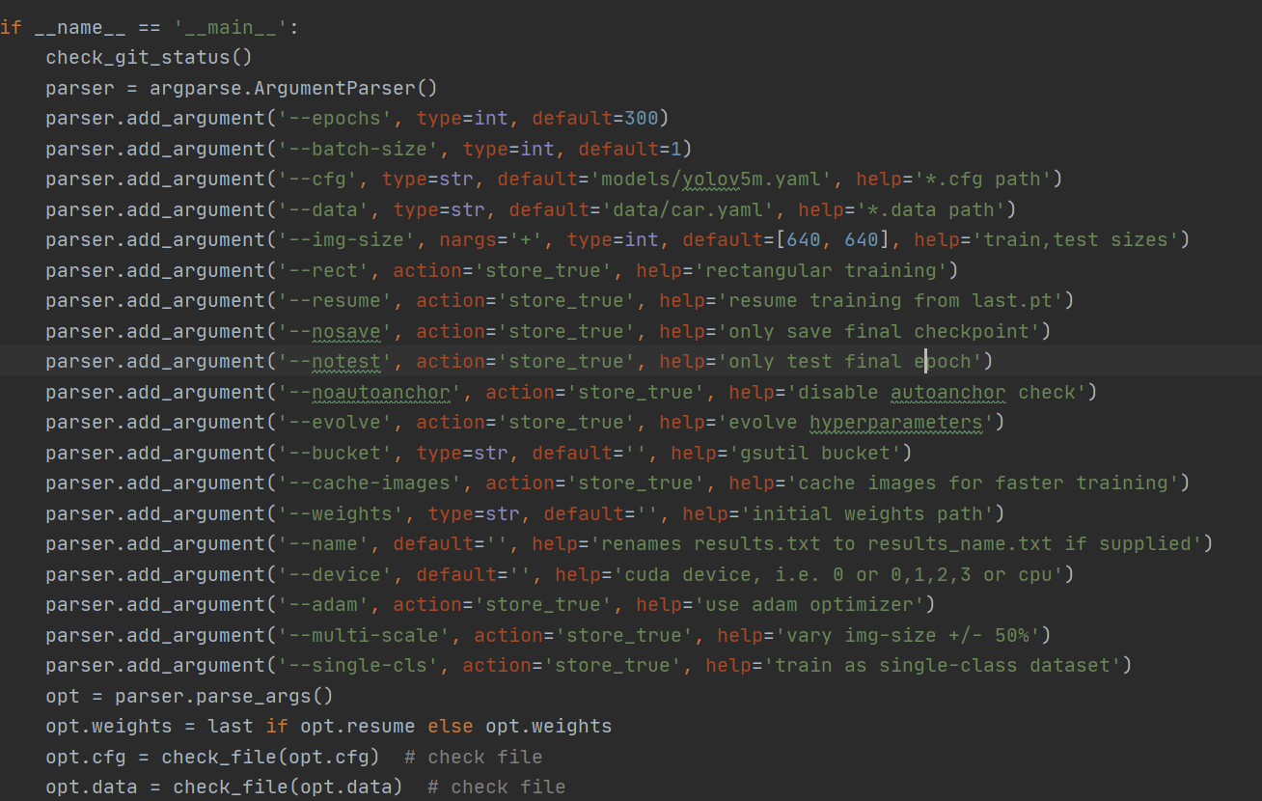
Training process
epochs = 300
Image size 640x640
yolov5m model

Slide 4
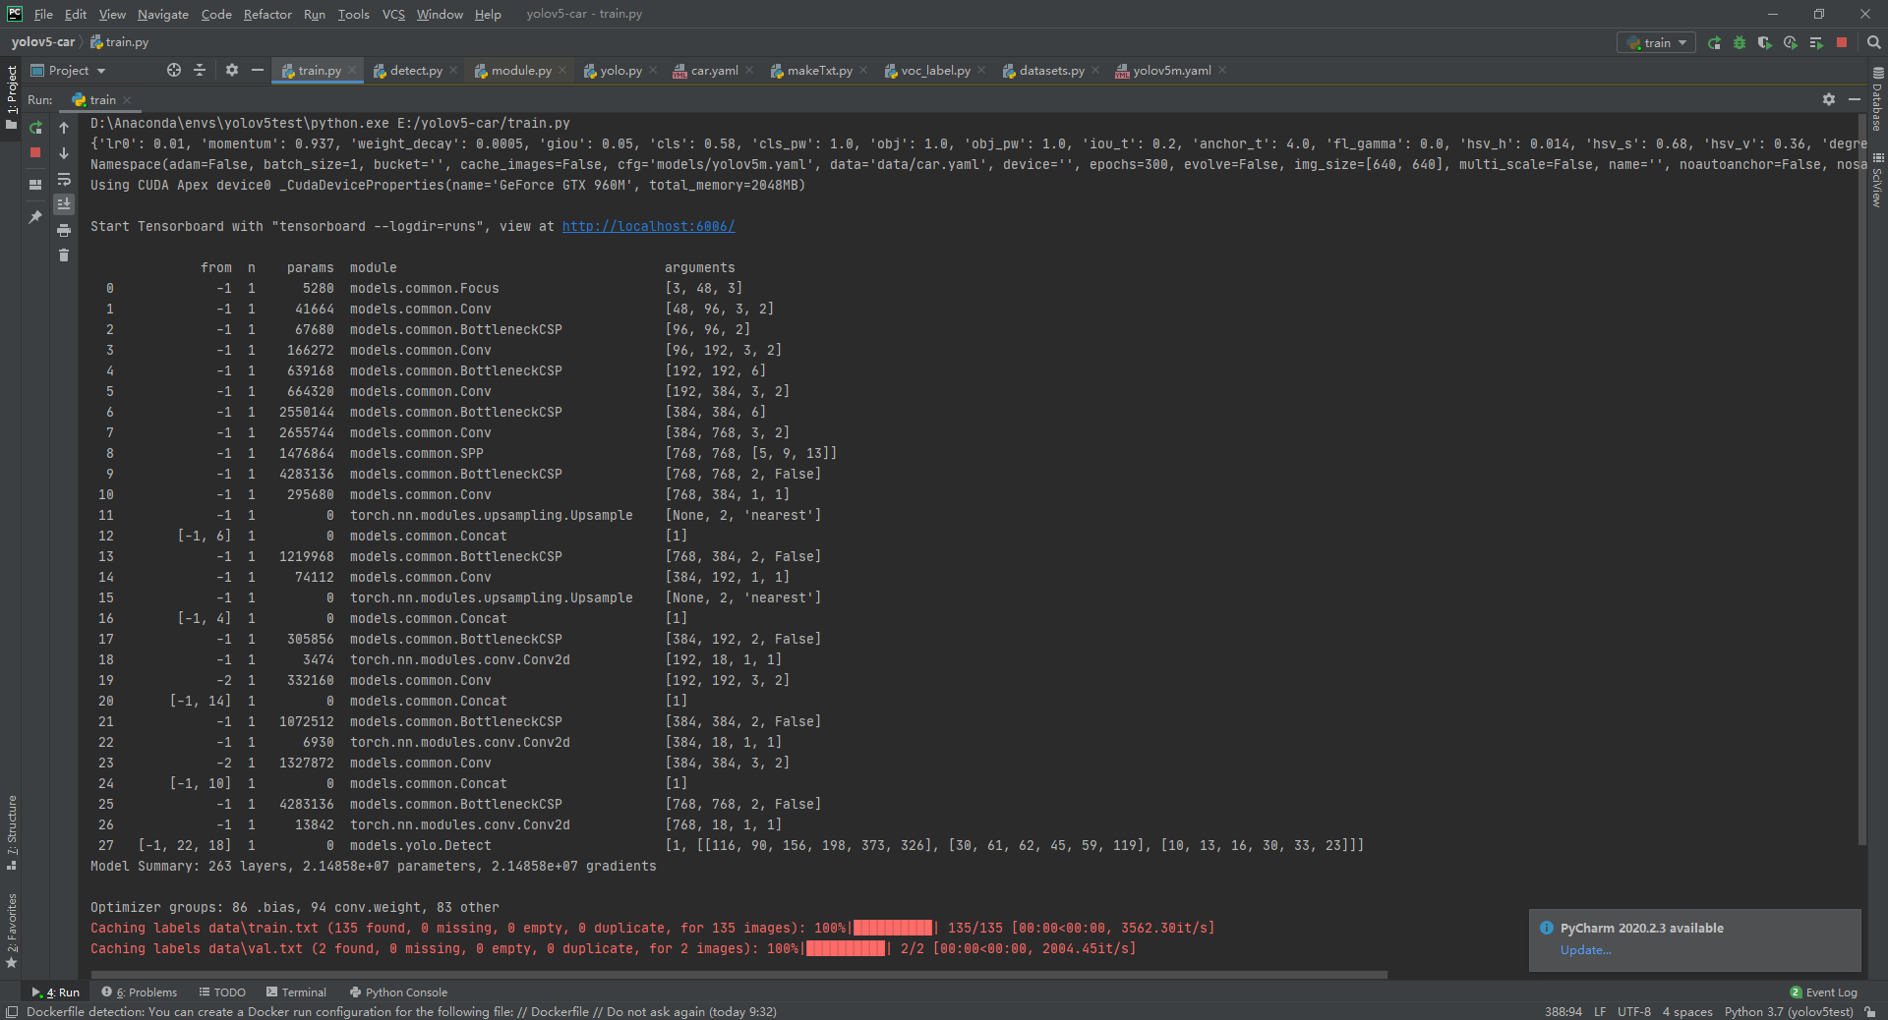
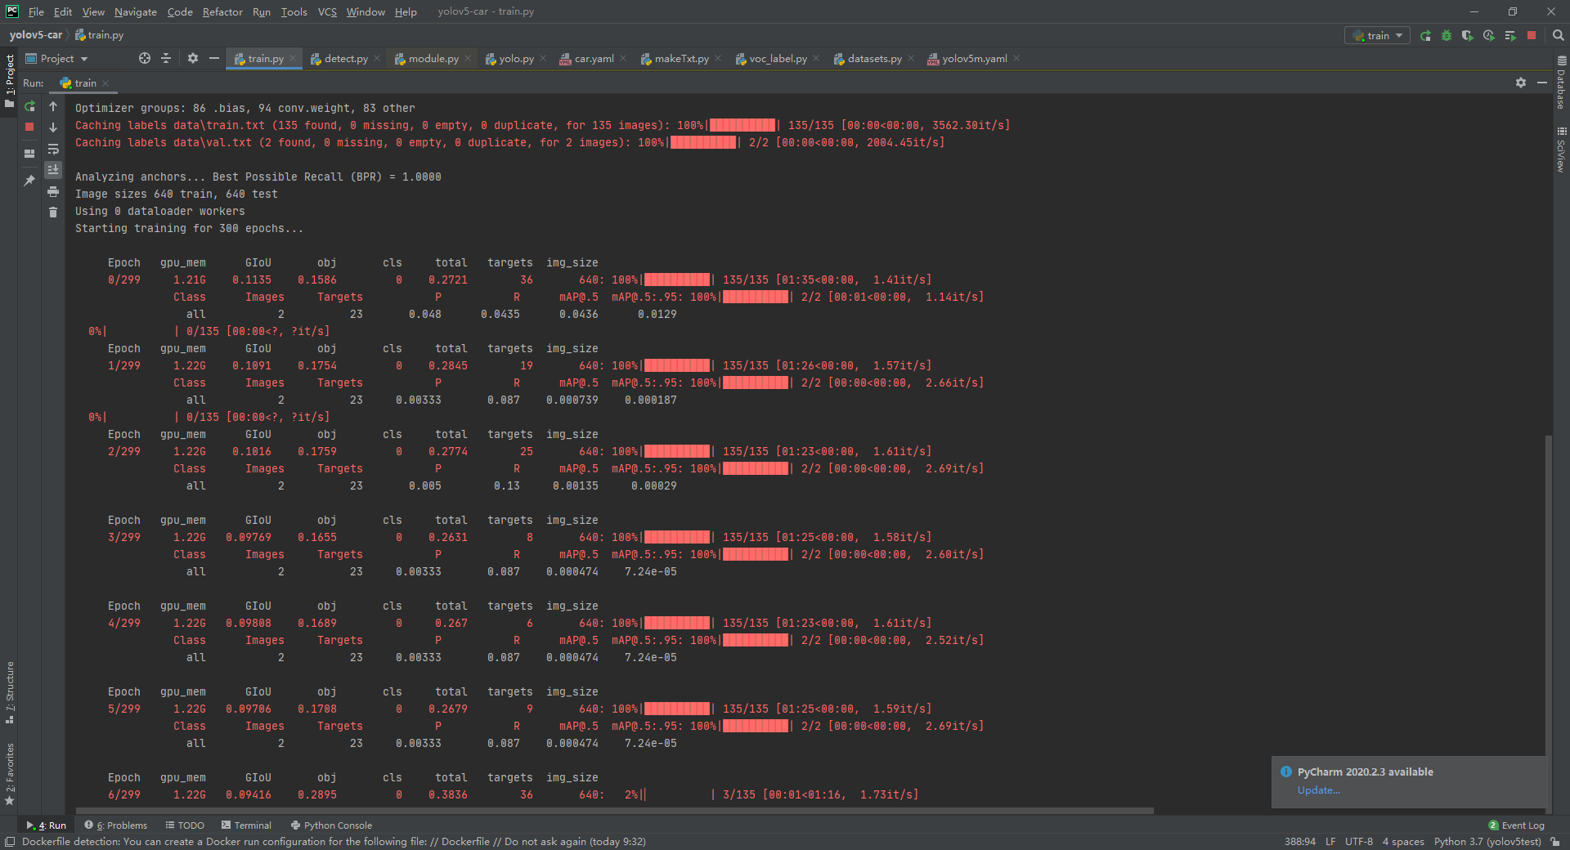
Training process
estimated time is about 5 hours. (limited by the gpu, GeForce GTX 960M)

Slide 5
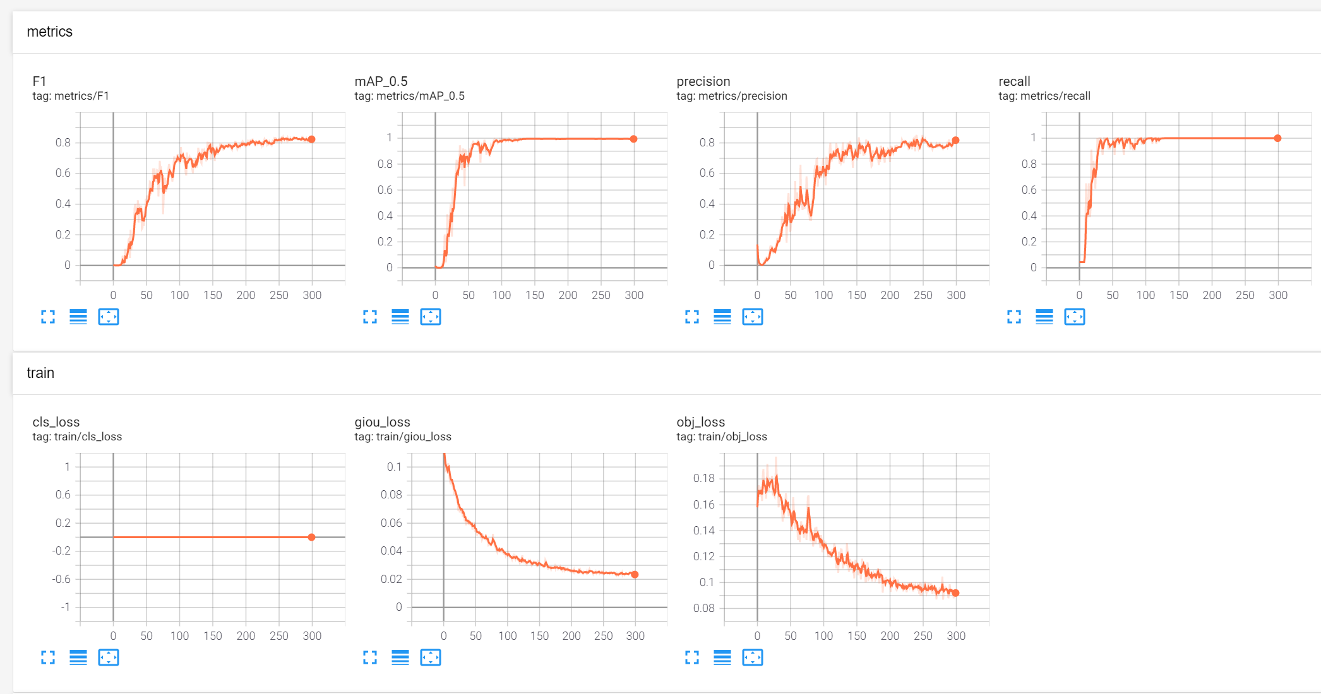

Training result: accuracy:0.95, loss:0,1
Generates a weight file which will be used to detect

Slide 6
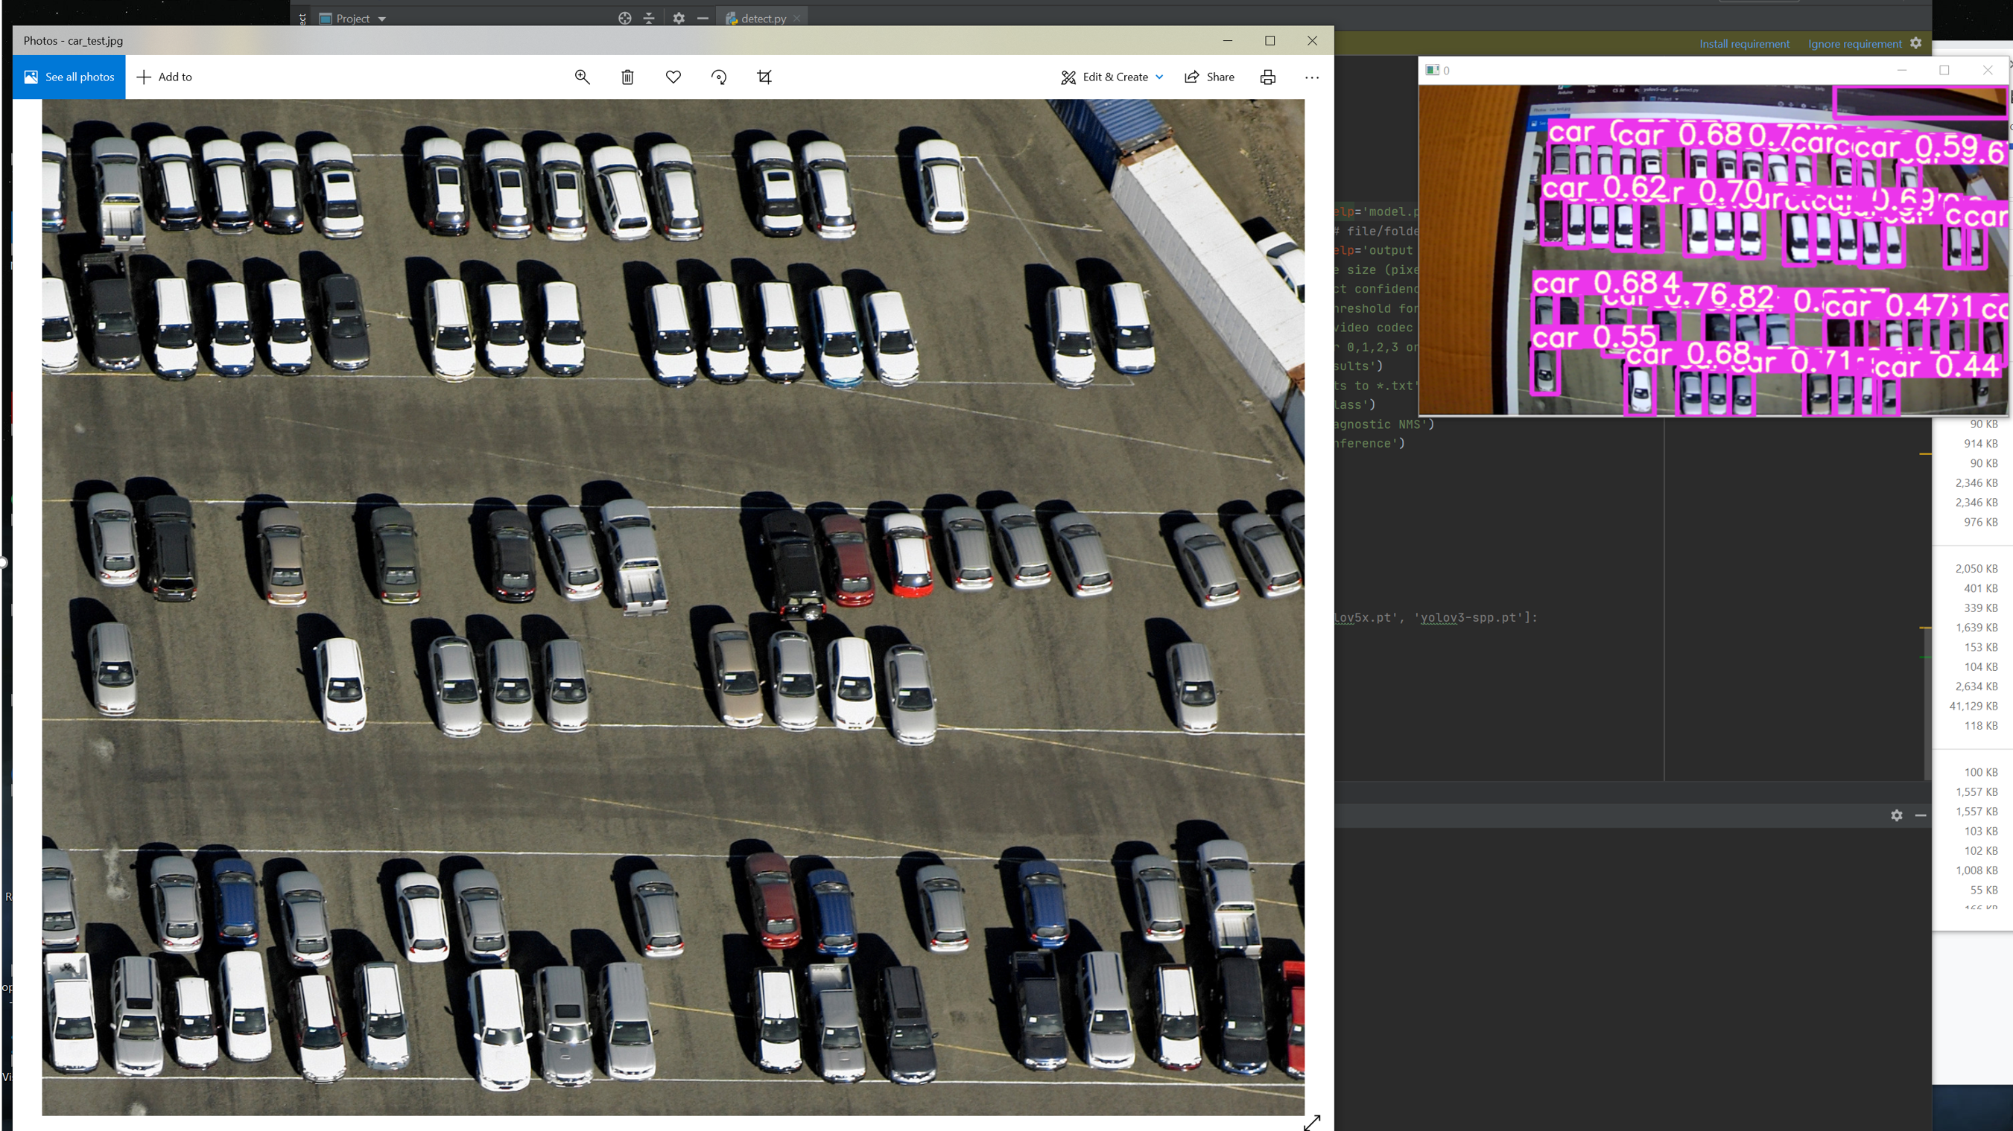
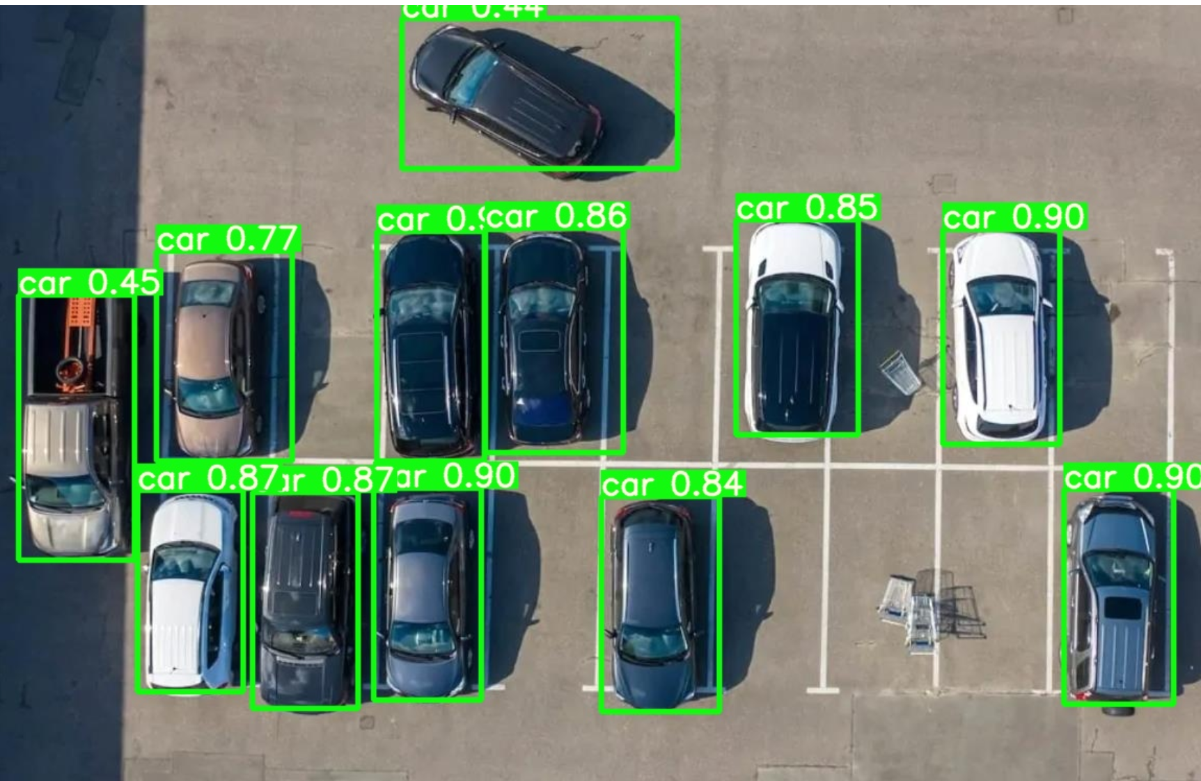
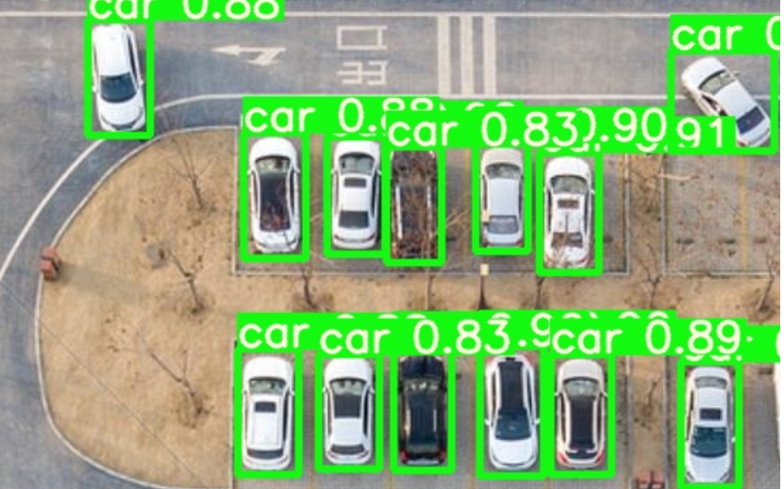
Using camera to test
Loading images to test

Slide 7
Reference
https://github.com/ultralytics/yolov5
https://www.tensorflow.org/tensorboard
https://www.shutterstock.com/search/parking+lot+top+view

